Slide 1
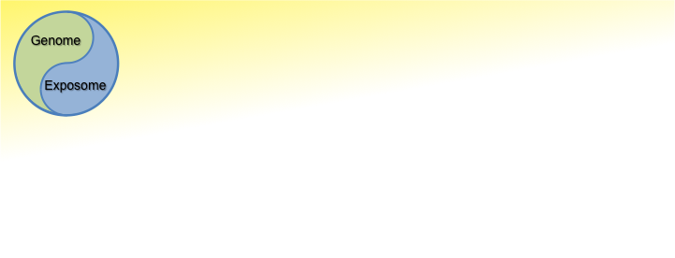

June 5, 2014
Emory University Department of Medicine
Clinical Biomarkers Laboratory
UAB Metabolomics Workshop
Metabolomics Pathway Analysis
Dean P. Jones, Ph.D.
Department of Medicine/Division of Pulmonary,
Allergy and Critical Care Medicine
Emory University, Atlanta
No financial COI to disclose
EMORY
SCHOOL OF
MEDICINE
Funding Acknowledgements: NIEHS, NIA, NCI, NHLBI, NIDDK, NIAAA, NIAID, DoD, Woodruff Foundation, Emory Dept of Medicine, Georgia Research Alliance

Slide 2

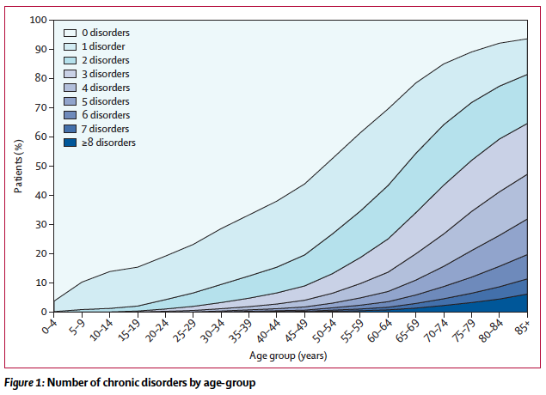

Slide 3
Proportion of cancer deaths attributed to various environmental factors (Doll and Peto)
Infection 10% (?)
Geophysical 3%
Medical Treatments 1%
Consumer Products <1%
Pollution 2%
Occupational 4%
Sexual Behavior 7%
Food Additives <1%
Unknown ?%
Tobacco 30%
Diet 35%
Alcohol 3%

Slide 4
Healthy longevity is limited by morbidity
Risk is a combination of genomics and exposures
10-20% of disease risk
Genome
Exposome
GxE interactions account for 80-90% of disease risk
Jones et al 2012 Annu Rev Nutr 32:183-202

Slide 5
“Exposome” Concept
Wild defined the “Exposome” as all exposures from conception onwards, including those from lifestyle, diet and the environment.
Wild (2005) Cancer Epidemiol Biomark Prevent 14:1847
“The Nature of Nuture”
Refined definition includes accumulated biologic responses to exposure (e.g., mutations, epigenetic changes)
GW Miller & DPJones (2014) Tox Sci 137:1-2
Notes:
5

Slide 6
June 5, 2014
Emory University Department of Medicine
Clinical Biomarkers Laboratory
UAB Metabolomics Workshop
Metabolomics to Sequence the Exposome
Experts concur that the human metabolome includes >1,000,000 low MW chemicals
40 nutrients
2000 intermediary metabolites
200,000 food constituents
200,000 peptides
500,000 lipids
100,000 microbiome metabolites
10,000 drugs and drug metaboites
100,000 environmental chemicals & metabolites
EMORY
SCHOOL OF
MEDICINE
The magnitude of the metabolome emphasizes the need for new analytic strategies

Slide 7

Dad: “What did you do at school today?”
Chris: “We learned how to count to 2 million.”

Slide 8
Dad: “What did you do at school today?”
Chris: “We learned how to count to 2 million.”
Dad (Obviously impressed): “Wow. How do you do that?”

Slide 9
Dad: “What did you do at school today?”
Chris: “We learned how to count to 2 million.”
Dad (Obviously impressed): “Wow. How do you do that?”
Chris: “One million….two million.”

Slide 10
Dad: “What did you do at school today?”
Chris: “We learned how to count to 2 million.”
Dad (Obviously impressed): “Wow. How do you do that?”
Chris: “One million….two million.”
(This is Dad speaking):
To understand the complexity in human health and disease, there is no choice but to abandon reductionist thinking

Slide 11
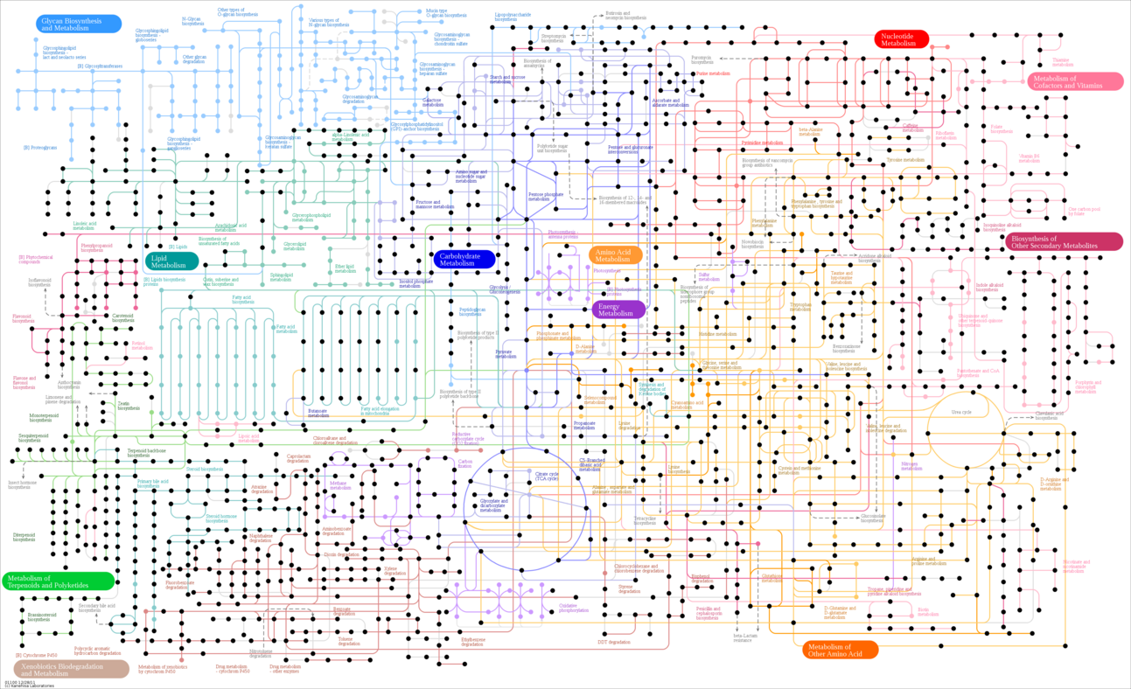
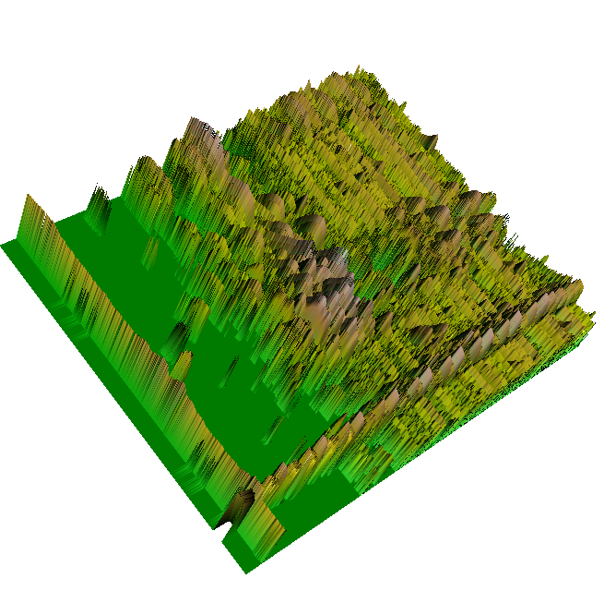
High-resolution metabolomics developed at Emory measures individual biochemistry with resolution approaching that for genomics
Measure 20,000 chemicals in an individual plasma sample
Relative
intensity
Technologies appear to be good enough to measure 1 million chemicals
Time
Mass/charge
Jones et al 2012 Annu Rev Nutr 32:183-202
Notes:
11

Slide 12
June 5, 2014
Emory University Department of Medicine
Clinical Biomarkers Laboratory
UAB Metabolomics Workshop
Practical aspects of high-resolution metabolomics:
Fourier transform instruments are now available at similar cost to Q-TOF Has higher resolution and mass accuracy for lower abundance ions
Main limitation is scan speed to obtain high resolution
Sensitivity is driven by
1) Dedicate use without putting random chemical garbage on the instrument
2) Analysis under rigorously defined, routine conditions
3) Dedicated continuous use (24/7) for 25 day run cycle
4) Analysis in triplicate; dual chromatography
5) Advanced computational methods for data extraction
T Yu et al 2009 Bioinformatics 25:1930-6
JM Johnson et al 2010 Analyst 135: 2864-2870
Q Soltow et al 2011 Metabolomics DOI: 10.1007/s11306-011-0332-1
K Uppal et al 2013 BMC Bioinformatics 14:15
T Yu et al 2013 Journal of Proteome Research 12:1419-27
EMORY
SCHOOL OF
MEDICINE

Slide 13

High-resolution metabolomics to sequence the exposome
Current Metabolomic Capabilities: >20,000 metabolites (>100,000 ions by LCMS)
40 Essential nutrients
2000 intermediates formed by enzymes encoded by the genome
Core Nutritional Metabolome
Food
metabolome
Non-nutritive Chemicals in Diet
Plant metabolome >200,000 chemicals
Microbiome-related Chemicals
Largely uncharacterized (may be 10-40% of plasma metabolome)
Supplements and Pharmaceuticals
>1000 drugs in use
Commercial Products
>10,000 agents used
>80,000 registered with EPA
Environmental
metabolome
Environmental Chemicals
Jones et al Annu Rev Nutr 2012
Notes:
13

Slide 14
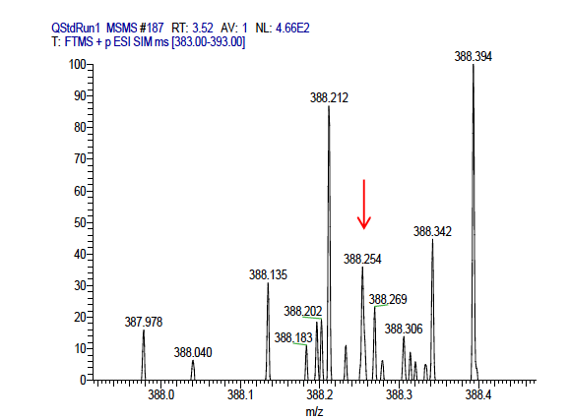
Resolution and mass accuracy of high-resolution mass spectrometers allow unprecedented detection of low-abundance ions in human plasma and other complex mixtures
Uppal et al BMC Bioinformatics 2013
Notes:
14

Slide 15
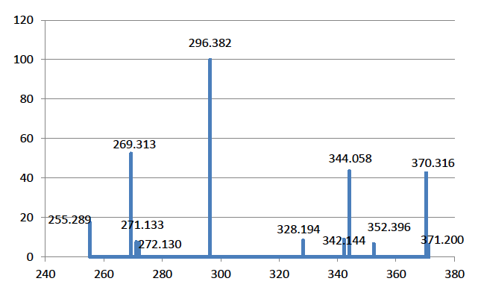
Deconvolution MS/MS for Identification of Low-Abundance Ions
Predicted
MS/MS
Uppal et al BMC Bioinformatics 2013
Notes:
15

Slide 16
Alternate Workflows
Targeted Metabolomics
High-resolution metabolomics
Select analytic target to test hypothesis
Pose scientific question (with or without hypothesis)
Select relevant samples
Select and test analytic method
Analyze samples by high-resolution MS with advanced data extraction algorithms
Perform power calculation; design experiment
Use bioinformatic methods and database tools to obtain significant metabolites and pathways
Conduct experiment
Analyze samples and perform statistical analysis
Perform MS/MS and co-elution studies to verify metabolites

Slide 17

Sequencing the Exposome
A framework is available:
Lifecycle models for
diet and nutrition
Aging Metabolome
Lifelong Exposures
Adult Metabolome
Adolescent and Pubertal Metabolome
Early Development Metabolome
Fetal Metabolome
Early Embryogenesis Metabolome
Start with cross-sectional, extend to longitudinal
Maternal and Paternal Metabolome
Jones et al Annu Rev Nutr 2012
Notes:
17

Slide 18
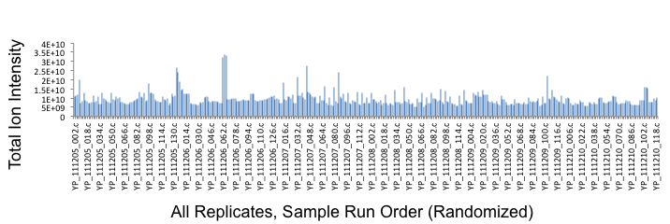
Sample analysis (C18) shows that there is consistent LCMS system response during weeklong analysis period.
Triplicate analyses are reproducible
Random high response probably represents a residual problem with sample processing or inconsistencies in complex system (sample, autosampler and injector components, multiple valves, electrospray inhomogeneities or electromagnetic properties of ion transfer tube)

Slide 19
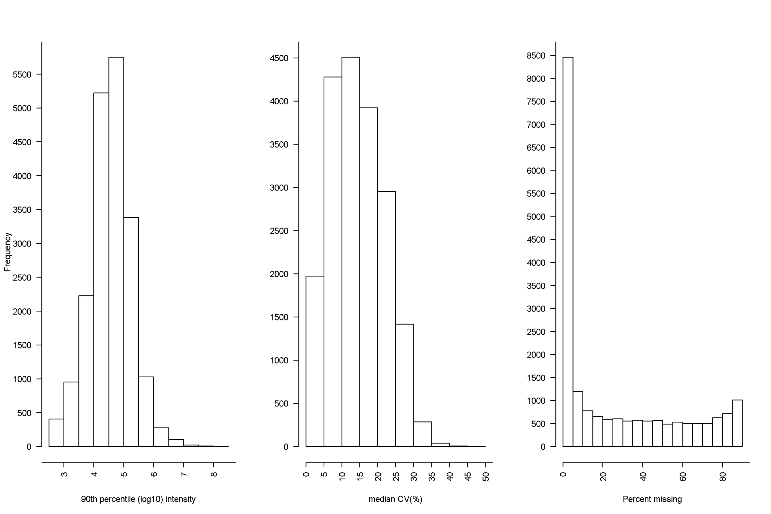
xMSanalyzer data for 174 serum samples (K Uppal et al BMC:Bioinformatics 2013)
Improved data extraction over most approaches: 34,768 ions, triplicate analyses
Summary for C18: 19,383 ions Range of detection over 5 orders of magnitude of intensity
With triplicate analyses, CV is obtained for each metabolite in each sample:
6,247 had median CV < 10% Mean intensity of ions with CV <10%: 3.0 x 10⁵
Intensity
Mean: 1.2 x 10⁵ Median: 2.0 x 10⁴
CV
Median: 14.4%
Missing values
>8000 had <5% missing values
(enriched in intermediary metabolites)
Ions with different missing values appear to reflect variable dietary and environmental agents
Enriched in intermediary metabolites
Frequency
Ion intensity
CV
% missing values
Notes:
This slide illustrates the characteristics of the high-resolution metabolomics data obtained for the 174 subclinical CVD analyzed to date.
Important characteristics: Improved detection; many metabolomics methods only provide 300 metabolites. Method using high-resolution mass spectrometry, triplicate analysis and improved data extraction methods (Uppal et al, BMC Bioinformatics, in press) detects over 30,000 ions. While some ions are derived from the same chemical, correlation analyses show that most represent unique chemical entities and consistent with detection of >20,000 metabolites.
For more conservative statistical analyses, >6000 ions have CV < 10% and >8000 have <5% missing values; these are enriched in intermediary metabolites and include high-resolution matches to more than half of the chemicals in the KEGG human metabolic pathways.

Slide 20
Detected m/z features matching half of known human intermediary metabolites (KEGG) are shown in black; most human metabolic pathways are represented
Glycan
metabolism
Lipid
metabolism
Carbohydrate
metabolism
Amino acid
metabolism
Nucleotide
metabolism
Cofactor
metabolism
Xenobiotic
metabolism
Terpenoid
metabolism
Energy
metabolism
Other secondary
metabolism
Other amino acid
metabolism
Soltow et al Metabolomics 2011; Yu et al Bioinformatics 2009; Uppal et al BMC Bioinformatics 2013: Yu et al J Proteome Res 2013
Notes:
The high-resolution metabolomics platform provides precise metabolic phenotyping to support personalized management in HD; ions detected match more than half of the known human intermediary metabolites and include metabolites from most human metabolic pathways.

Slide 21
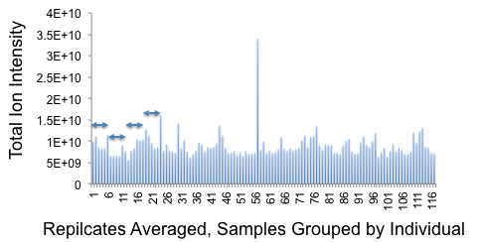
Averages of replicates includes random variation of individual high values but otherwise shows that individuals have relatively consistent total signal.
It is not clear whether individuals have differences in total signal due to amount of total metabolites—we concluded in our earlier NMR studies of SAA insufficiency that this occurred, perhaps due to differences in amount of albumin
An alternative possibility is that there are specific chemicals in some individuals that have global effects on ionization. This could be NaCl content, phosphate, sulfate, total lipid or other high-abundance chemical. Expectation is that it would be principally impacting the initial (salt) washthrough

Slide 22
Advanced data extraction algorithms (with relaxed stringency compared to usual analytic standards) support measurement of >20,000 chemicals in human samples
Study of ICU patients (>22,600 ions measured); up to 6 repeat measures on 24 individuals for 4 weeks (12 who survived and 12 who died)
Ion matching PFOS show reproducible detection in 4 out of 24 patients
Repeat measures show generally consistent data despite high CV
Unidentified chemical (mz 400.1035, 323 s) correlated with PFOS is higher in patients who died
Despite the need to improve analytic methods, data show that high-resolution metabolomics can associate unidentified chemicals with human health
Collaboration with TR Ziegler, GLND study
Notes:
22

Slide 23
Examples of unidentified* ions that differ between survivors and deceased patients in 4-week ICU study
*High-resolution m/z did not match common ion forms of chemicals in Metlin database
Representative ions from 44 that were significantly different (2-way ANOVA FDR <0.05) between 12 survivors and 12 deceased patients
Samples were randomized prior to analysis and then resorted after LCMS according to survival classification
Collaboration with TR Ziegler, GLND study
Notes:
23

Slide 24
MWAS of age-related macular degeneration reveals environmental associations in humans
*Present >50% of samples
Significant at q=0.05
m/z 308.857
m/z 353.103*
m/z 376.845
-log p
m/z
Database matches
308.857: pentachlorocyclohexanol
376.844: pentachlorodibenzodioxin
Osborn et al PLOS ONE 8(8): e72737

Slide 25

Cascade Plot: Non-specific correlations exist in metabolomics data
Correlation of one metabolite with all others, ordered according to R
p=0.05
p=0.05
R=0.3
Pearson R for correlation
R=-0.3
q=0.2
q=0.2
1000
2000
3000
4000
5000
Ordered metabolite number
Probably reflects analytic effects (sample collection, transfer, extraction, injection)
and biologic effects (intestinal absorption, renal function, liver function, hydration)
Data filtration to reduce this non-specific effect decreases statistical penalty of multiple comparisons

Slide 26
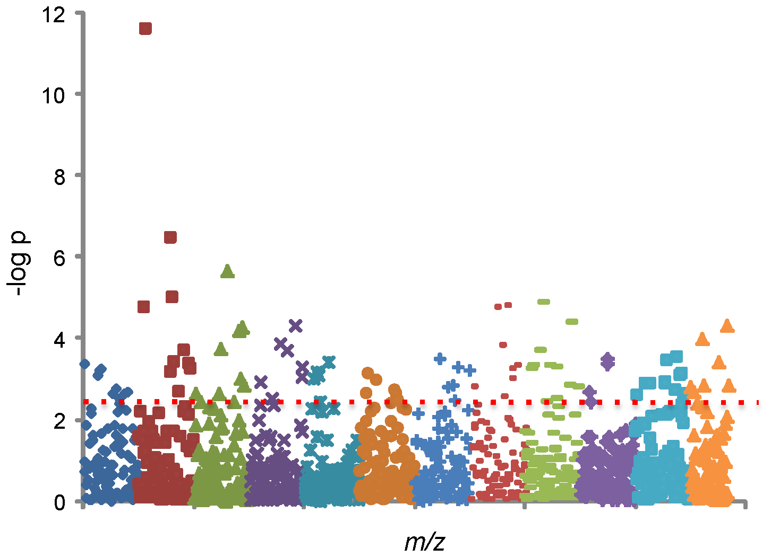
Manhattan plot: y-axis represents the negative log₁₀ of p-value
(higher is better) and the x-axis represents the measured m/z
FDR 0.05
Osborn et al PLOS ONE 8(8): e72737

Slide 27
Hierarchical clustering using 45 samples (19 Control vs 26 AMD) and 16 differentially expressed metabolites
Control: Red
AMD: Green
Osborn et al PLOS ONE 8(8): e72737

Slide 28
Emory University
Department of Medicine
June 5, 2014
Clinical Biomarkers Laboratory
UAB Metabolomics Workshop
Key components of pathway analysis
Statistical testing: FDR
Metabolite-metabolite Correlation Analyses
Online Databases/Resources
Cross-platform Studies
EMORY
SCHOOL OF
MEDICINE

Slide 29
Simple pathway mapping strategies
Use Metlin (http://metlin.scripps.edu/metabo_batch.php ) to capture matches to m/z features as KEGG ID (download CSV file into Excel)
Copy KEGG ID column into new spreadsheet; Use “sort” and “delete duplicates” commands to obtain clean list of KEGG ID
Cut and paste list of KEGG ID into KEGG Compound
(http://www.genome.jp/kegg/compound/ ); select “Pathway Mapping”; select “show all objects”; can go to specific pathways
Use MetaboAnalyst and take what you get
Use Mummichog and take what you get
Use MetaCore and take what you get
Use Metscape and make pretty pictures

Slide 30
Metabolome-wide association study (MWAS)
Plot the negative log p as a function of m/z or as a function of retention time
Manhattan plot
Type 2 Manhattan plot
These figures are generated in Excel. Green is no difference at FDR cutoff. Red represent positively correlated and blue is negatively correlate metabolite.

Slide 31
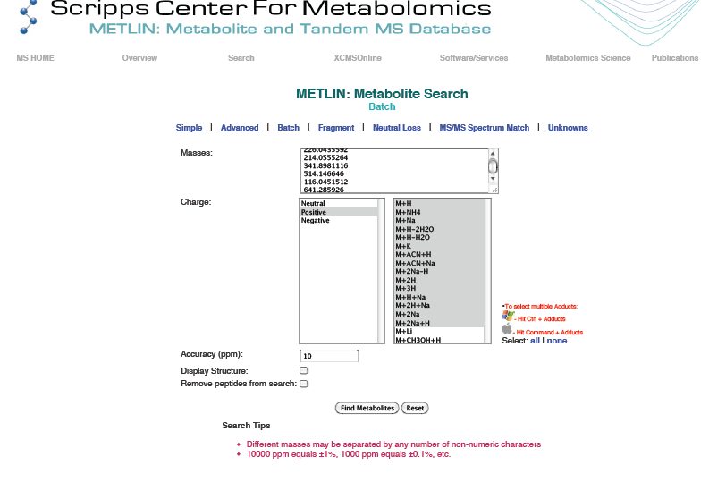

Slide 32
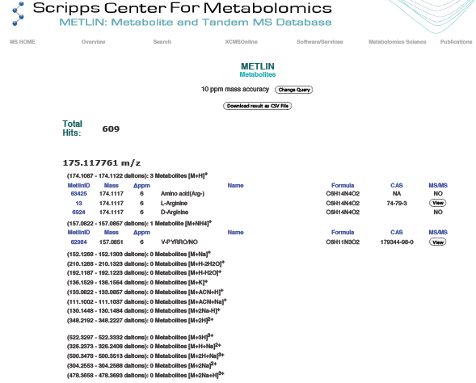

Slide 33
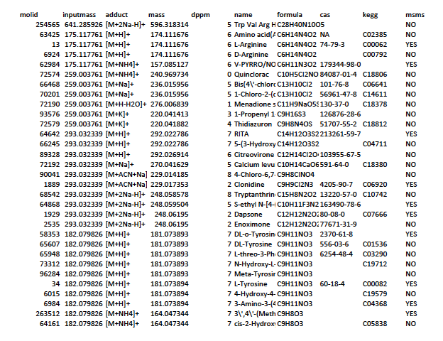

Slide 34
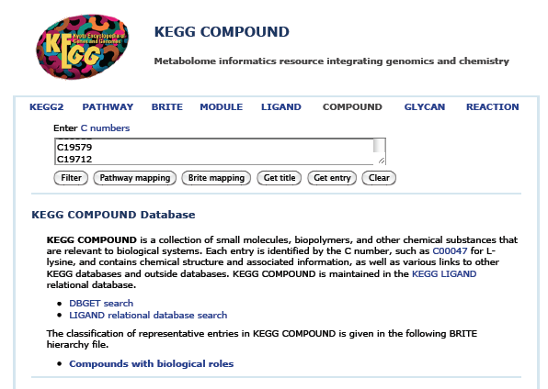

Slide 35
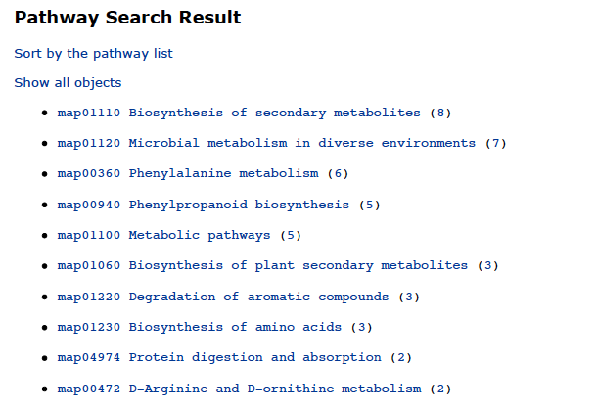

Slide 36
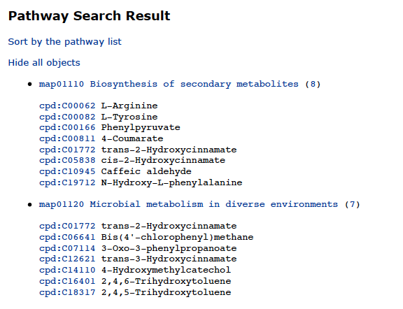

Slide 37
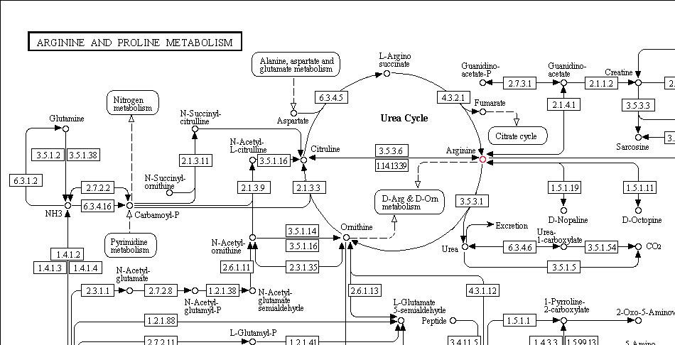

Slide 38
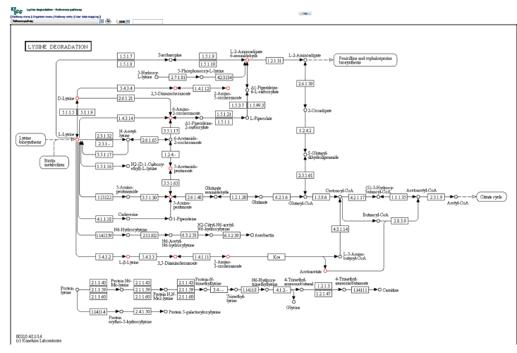

Slide 39
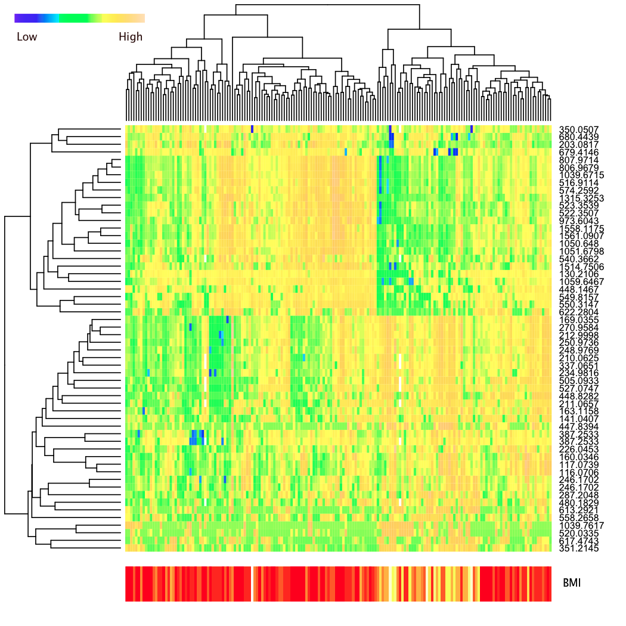
Hierarchical cluster analysis of subjects according to most significant metabolites that differ according to BMI
EMORY
SCHOOL OF
MEDICINE
Two major clusters of individuals
Includes individuals with high BMI
Major clusters of metabolites
Two include
High levels of blood lipids
BMI; yellow = high

Slide 40
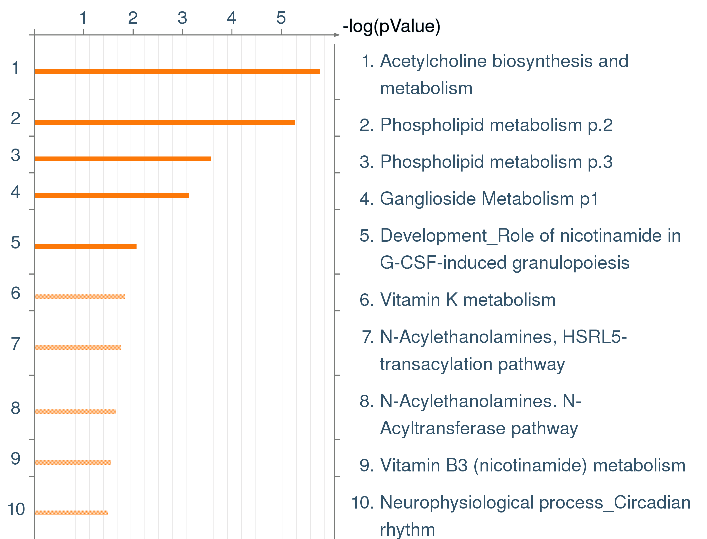
Pathway enrichment analysis using MetaCore

Slide 41
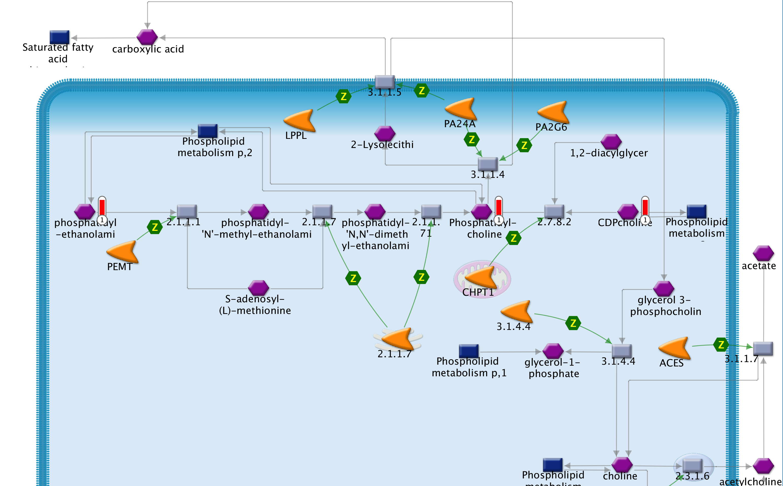
Acetylcholine biosynthesis and metabolism
C00157;
m/z 832.6778
C00307;
m/z 552.1232
C00350;
m/z 724.4745

Slide 42
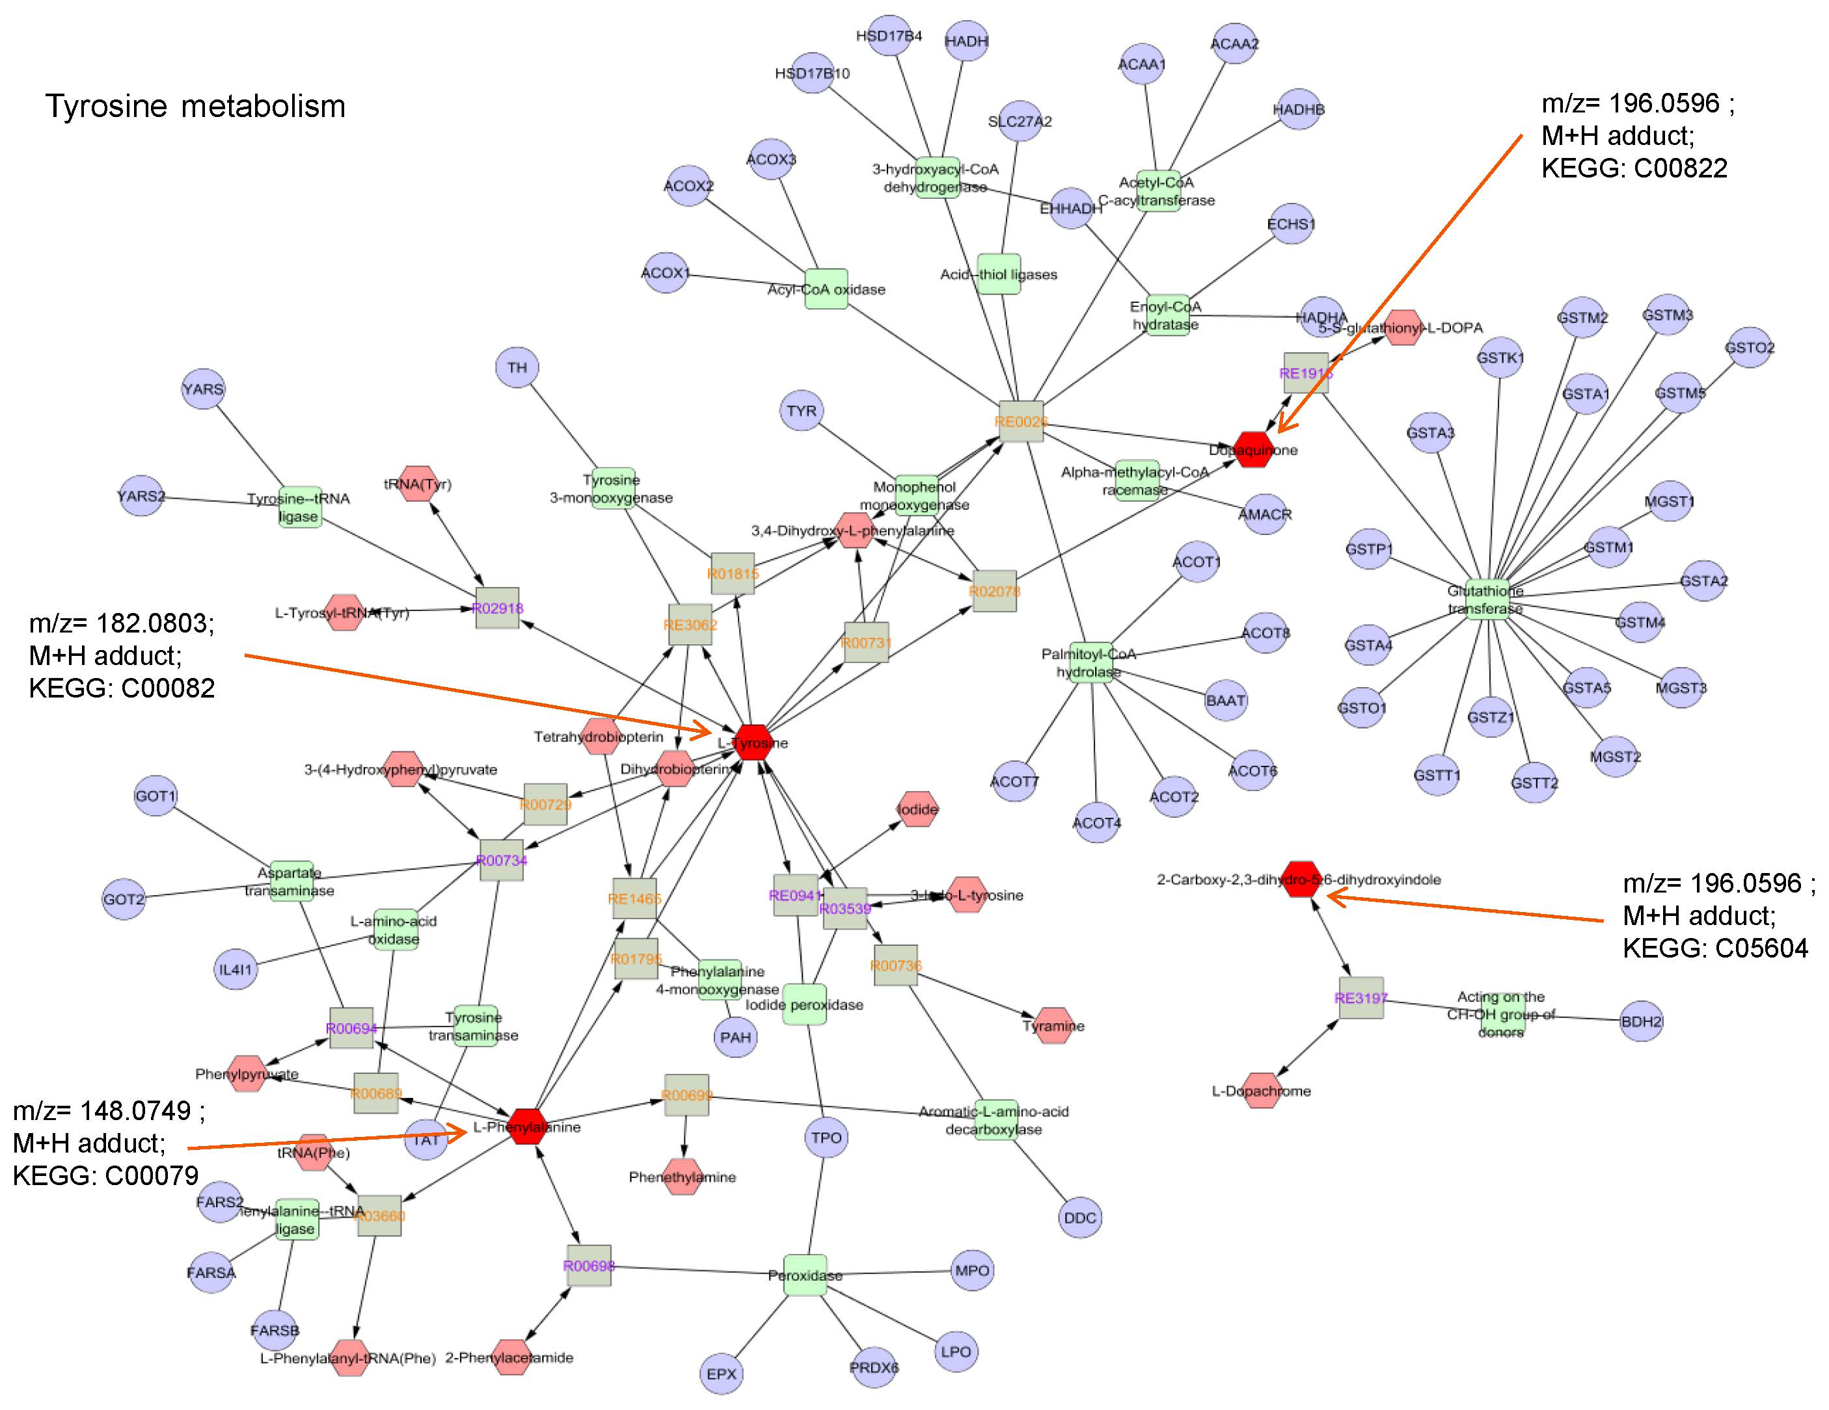
Metscape: Pathway mapping of discriminatory metabolites in disease
Age-related macular degeneration
Osborn et al PLOS ONE 8(8): e72737

Slide 43
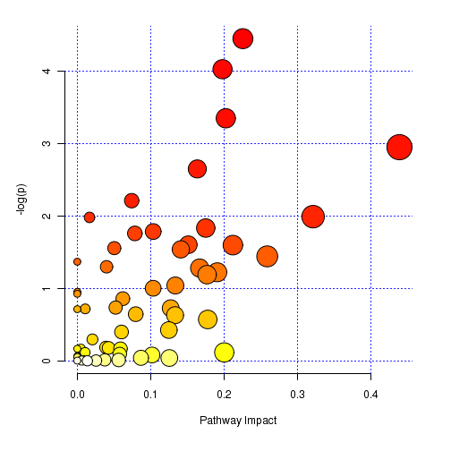
MetaboAnalyst: MetPA provides plot of significance and impact of metabolic pathways to separation of biological classes of samples
In this MetPA analysis, 199 matches to KEGG human compounds from 335 features significant by FDR (q=0.01) shows calculated impact of sphingolipid, vitamin B6 and amino acid metabolism
Vitamin B₆
metabolism
Branch-chain amino acid
metabolism
Gly, Ser, Thr
metabolism
Glu & Gln
metabolism
-log p
Sphingolipid
metabolism
Pathway Impact
Notes:
Optional figure showing that MetPA indicates impact of sphingolipid metabolism, and vitamin B6 and amino acid metabolism on differences in sub-classes of AMD. Analysis with MetPA use 199 KEGG Human cpds from FDR 335 (q=0.01) significant features.

Slide 44
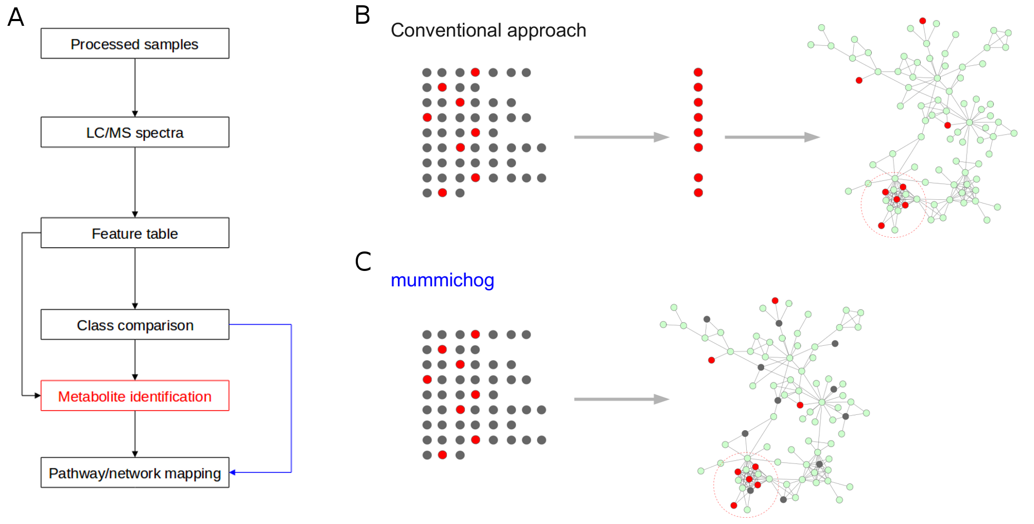
Mummichog combines metabolite prediction and network analysis in one step
Shuzhao Li et al, 2013 PLoS Computational Biology
Notes:
Mummichog redefines the work flow of untargeted metabolomics.
A) In the work flow of untargeted metabolomics, the conventional approach requires the metabolites to be identified before pathway/network analysis, while mummichog (blue arrow) predicts functional activity bypassing metabolite identification.
B) Each row of dots represent possible matches of metabolites from one m/z feature, red the true metabolite, gray the false matches. The conventional approach first requires the identification of metabolites before mapping them to the metabolic network.
C) mummichog maps all possible metabolite matches to the network and looks for local enrichment, which reflects the true activity because the false matches will distribute randomly.

Slide 45
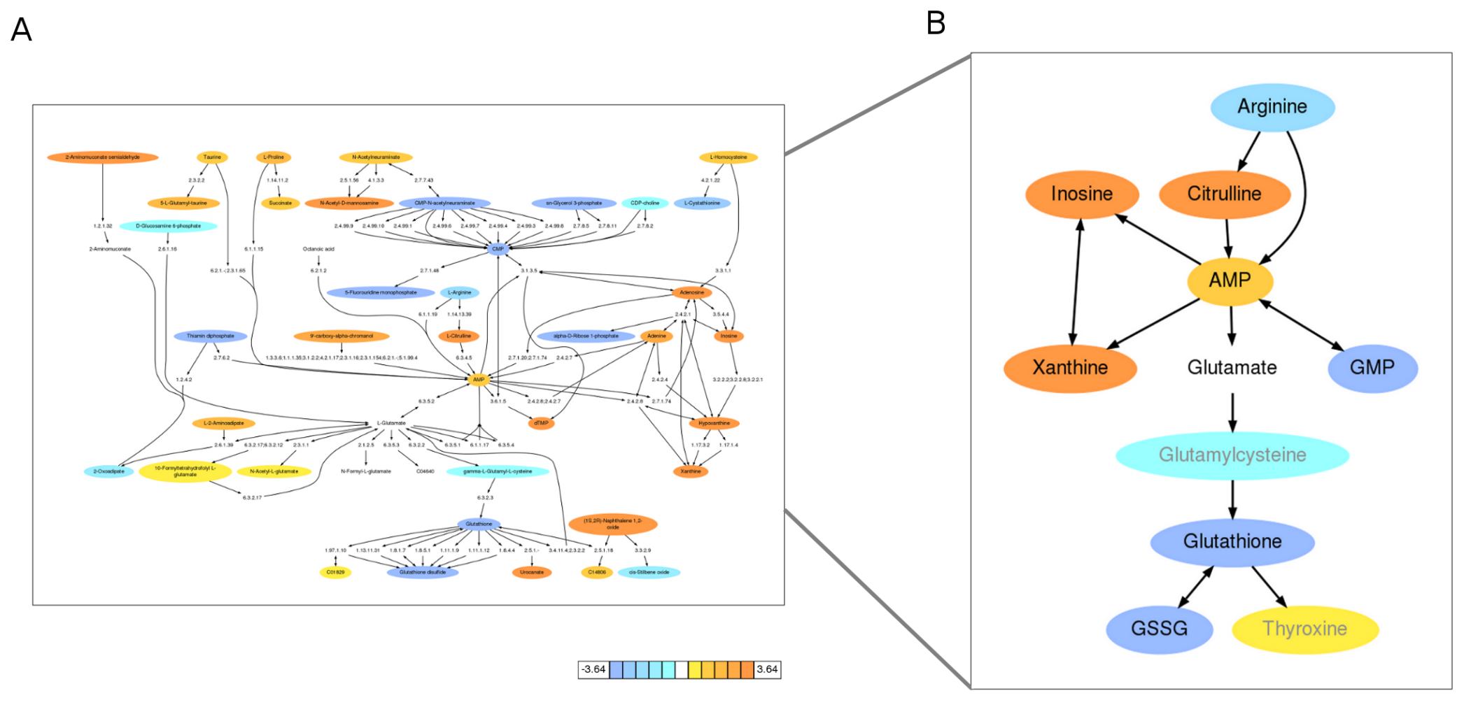
Activity network predicted by Mummichog in innate immune activation
Shuzhao Li et al, PLoS Computational Biology 2013
Notes:
Metabolic activity network in dendritic cells stimulated by yellow fever virus.
A) Prediction by mummichog directly from m/z feature tables (cell extracts after 6 hours of infection). Metabolites are colored according to log2 fold change.
B) Further investigation was focused on the subnetwork on the right. Glutamate was not significantly altered, but included for network connectivity. All the metabolites, except glutamylcysteine and thyroxine, were confirmed using tandem mass spectrometry.

Slide 46
Emory University
Department of Medicine
July 24, 2013
Clinical Biomarkers Laboratory
UAB Metabolomics Workshop
Integrated omics for pathway analysis
Genome x Metabolome
Epigenome x Metabolome
Transcriptome x Metabolome
Proteome x Metabolome
EMORY
SCHOOL OF
MEDICINE

Slide 47
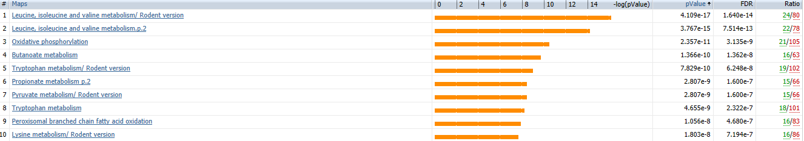
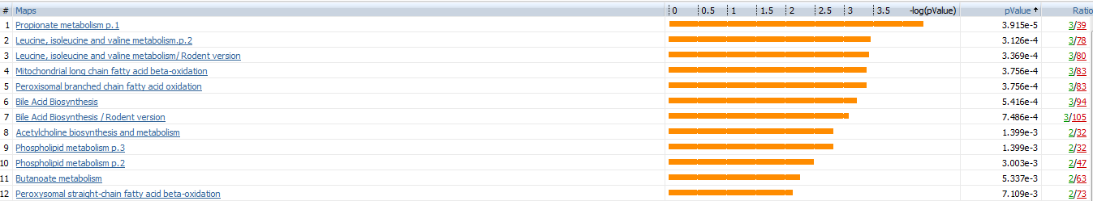
Redox proteomics: Major effects of Cd on mitochondrial branched chain amino acid system
Maps
1. Leucine, isoleucine and valine metabolism/ rodent version
2. Leucine, isoleucine and valine metabolism.p.2
3. Oxidative phosphorylation
4. Butanoate metabolism
5. Tryptophan metabolism p.2
6. Propionate metabolism p.2
7. Pyruvate metabolism/rodent version
8. Tryptophan metabolism
9. Peroxisomal branched chain fatty acid oxidation
10. Lysine metabolism/rodent version
Metabolomics: Major effects of Cd on mitochondrial branched chain amino acid metabolism
Maps
1. Propionate metabolism
2. Leucine, isoleucine and valine metabolism.p.2
3. Leucine, isoleucine and valine metabolism/Rodent
4. Mitochondrial long chain fatty acid beta-oxidation
5. Peroxisomal branched chain fatty acid oxidation
6. Bile Acid Biosynthesis
7. Bile Acid Biosynthesis/Rodent
8. Acetylcholine biosynthesis and metabolism
9. Phospholipid metabolism p.3
10. Phospholipid metabloism p.2
Y-M Go et al, Tox Sci 2014

Slide 48
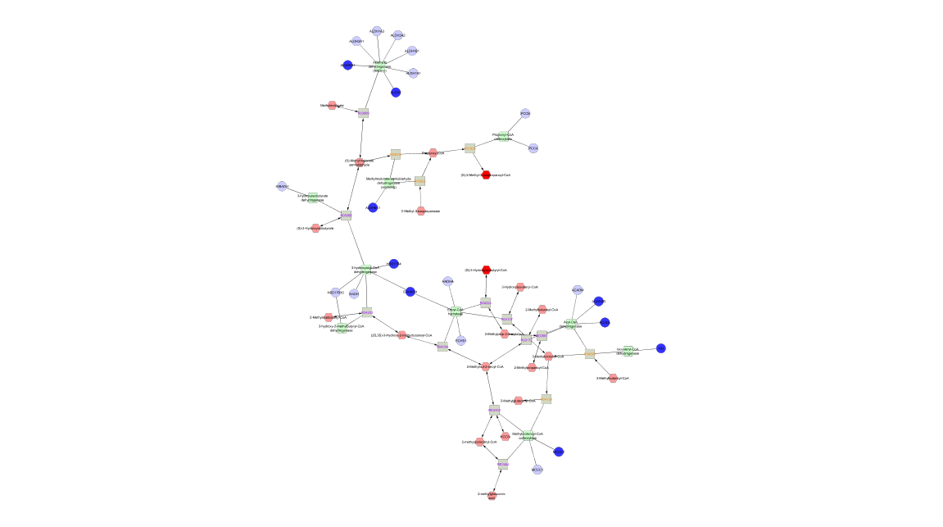
Metscape uses knowledge-based approach to map pathway interactions
Proteome x Metabolome
Aldehyde dehydrogenase 9
P x M
Aldehyde dehydrogenase 2
2-methylmalonyl-CoA
Aldehyde dehydrogenase 6
Hydroxysteroid dehydrogenase 4
3-Hydroxyisobutyryl-CoA
Acyl-coenzyme A
Coenzyme A dehydrogenase
Acyl-coenzyme A dehydrogenase
Isovaleryl coenzyme A
dehydrogenase
Proteins
Metabolites
Methylcrotonoyl-coenzyme A
carboxylase 2
Go et al (2014) Toxicol Sci

Slide 49
Cross-platform validation
Comparison C18-LCMS to automated amino acid analysis
Comparison C18-LCMS to Metabolon GCMS
Comparison C18-LCMS to Anion Exchange LCMS
LCMS AE
LCMS C18

